Slide 1
War of the Worlds
Day 3 of our fourth week of studying HG Wells’ great sci-fi novel War of the Worlds.
Chapter 9 The Fighting Begins continues the story so read on and enjoy. (3 slides)
Some useful definitions: slide 1 lassitude – weariness
slide 2 sappers – soldiers who are responsible for building, repairing roads etc
slide 3 lowing of a cow is the same as mooing
Please also remember this is an hour's work so take your time to read the text and questions carefully and answer in full sentences.
You do not need to understand every word and every last action – just try and make sure you have a good and clear overall understanding of who people are, where they are and what is happening.

Slide 2
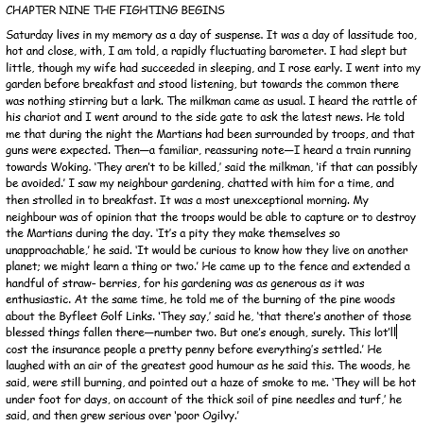
Questions: all on this slide and in chronological order
What sort of day was Saturday?
What were the only sounds that the narrator could hear from his garden?
What was the neighbour’s opinion about what would happen to the Martians?
Where else had been set alight?
Why were the woods going to be hot under foot?

Slide 3
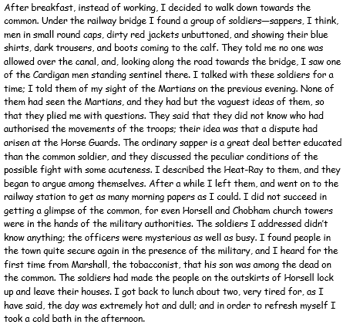
Questions: all on this slide and in chronological order
6) What did the narrator do instead of working?
7) Describe the appearance of the sappers.
8) Why did the narrator go to the station?
9) Whose son had died?
10) How did the narrator refresh himself?

Slide 4
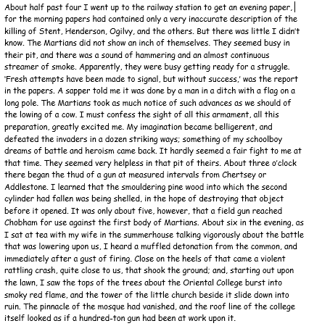
Questions: all on this slide and in chronological order
11) What time did the narrator go to get a paper?
12) What could be seen and heard from the pit?
13) Why was the narrator excited?
14) What were the guns shelling?
15) Do you think the soldiers will be successful in capturing or killing the Martians-give reasons, based on the text, for your answer?

