Slide 1
War of the Worlds
This is our fourth week of studying HG Wells’ great sci-fi novel War of the Worlds. We only have four days this week so no separate writing task.
Just recapping last week chapters 4, 5 and 6:
The ‘Thing’ or ‘Things’ have emerged and are hideous in appearance
The ‘Things’ launched their heat-ray are burned the men with white flags
The ‘Things’ then began to set fire to the surrounding countryside and everyone fled in terror.
Chapter 7 continues the story so read on and enjoy. (3 slides)
Remember the times in which the story was written and set:
Please also remember this is an hour's work so take your time to read the text and questions carefully and answer in full sentences.
You do not need to understand every word and every last action – just try and make sure you have a good and clear overall understanding of who people are, where they are and what is happening.

Slide 2
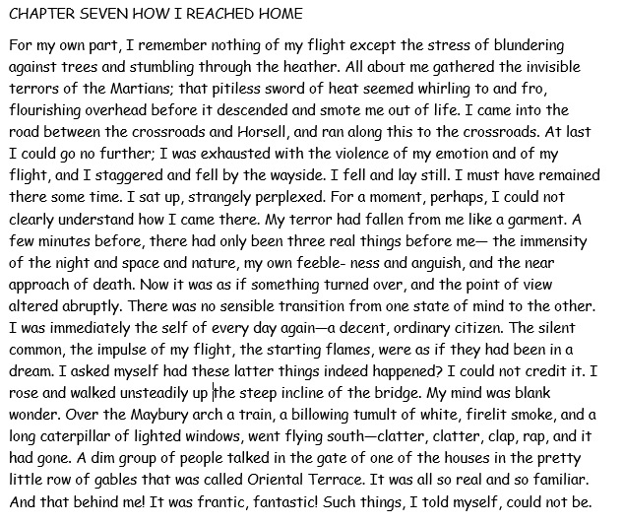
Questions: all on this slide and in chronological order
What were the only things the narrator could remember?
How did the narrator describe his nature?
Why did he seem to be normal again, ‘decent and ordinary’. How did he explain what had happened?
What two things di the narrator see and hear that made everything seem real and familiar?
How did he describe what was behind him?

Slide 3
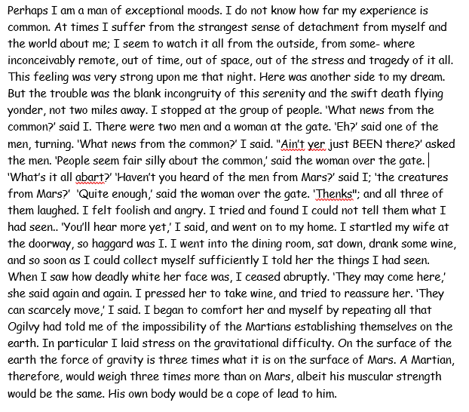
Questions: all on this slide and in chronological order
6) Why does the narrator think he may be different to others?
7) Who was at the gate where the narrator stopped?
8) What was the opinion of the woman at the gate about the Martians?
9) Why was the narrator’s wife startled by his arrival?
10) What was the narrator’s wife main worry about the Martians and how did the narrator try to comfort her?

Slide 4
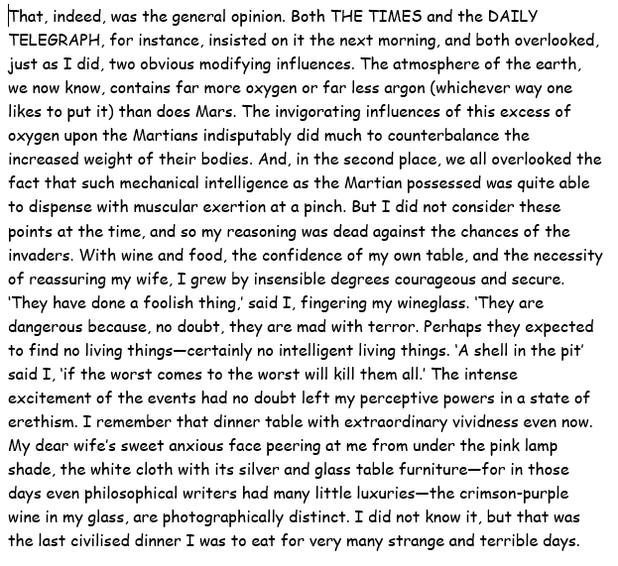
Questions: all on this slide and in chronological order
11) What two things had the narrator and the two newspapers forgotten when considering the effect of gravity on the Martians?
12) What does the narrator think will kill the Martians ‘if the worst comes to the worst’?
13) What can the narrator see so clearly?
14) Why do you think this is going to be the last civilized meal the narrator eats for some time?
15) Use a dictionary or other device to look up the meaning of the following words:
Invigorating
Exertion
Perceptive
Write a sentence using each one showing you understand their meaning.

