Slide 1
Top 11 facts on …. Fieldwork!

Slide 2
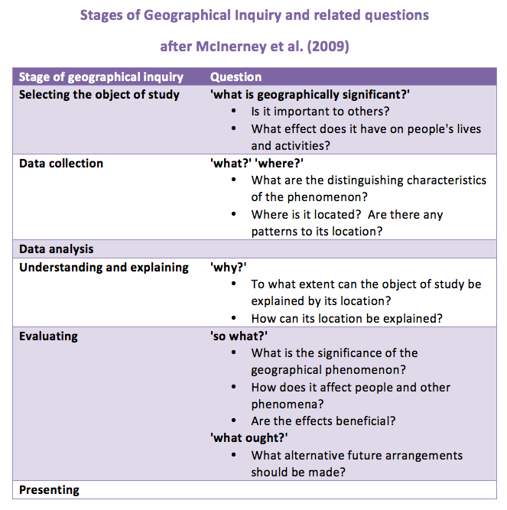
11. What’s the process?
You should be able to describe and explain the enquiry sequence…

Slide 3
10. Health and safety
This is an unlikely question, but it’s always better to be prepared!
Consider ‘common sense’ ideas e.g. walk on the pavement, use crossings, have contact numbers for staff/school, don’t survey people that make you feel uncomfortable etc.
Then consider some ‘site specific’ ideas e.g. sensible shoes so don’t slip on beach, be careful where cliffs are steep etc.

Slide 4
7. Secondary data
You may be asked to explain how secondary data helped you in your research; this refers to any data that has been collected by someone else
Examples you could consider are:
Last year’s Yr11 data to see changes over time
British Geological Survey for rock types
ONS for census data e.g. population structure
Estate agents for housing prices
Newspaper archives for old headlines/facts

Slide 5
6. Sampling methods
Random – it is impossible for our brains to be truly random so you would need to include a number generator (dice, random number table, phone number etc)
Systematic random – you choose a number and survey that site/person each time
Stratified – you work out the areas’s population proportions (gender, age, income etc) and survey in the correct proportions
Opportunistic – chance makes it available
Transect – a line through a site
Sampling methods are used to help avoid bias

Slide 6
5. Data presentation
You should be able to discuss several types of data presentation (e.g. maps, graphs, sketches etc.)
For each you should be able to explain why it is appropriate to the data you collected
E.g. annotated sketch of each site showed factors affecting the cliff characteristics and could be easily compared
E.g. proportional circles on a map showed how many pedestrians were seen at each site. It is easy to read and compare.

Slide 7
5. Data presentation
Maps – sketch maps, annotated OS/geology maps, flowline maps, choropleth maps
Graphs – bar, line, pie, histograms, scatter (&LOBF), pictograms, climate graphs, proportional circles, cross-sections, population pyramids
Other – annotated sketch, photos, diagrams, wordles

Slide 8
4. Data analysis
You should be able to complete some basic calculations on numerical data (e.g. 70% of people said…)
Most questions will ask for you to describe and explain what the data showed
You should also be able to:
- look at relationships between data sets (e.g. both the width and depth increased as you move downstream)
- Make predictions from your data trends

Slide 9
3.Conclusions
This is a summary of your main findings.
Ideally you should also be able to answer your original question and say whether your hypothesis was correct or incorrect (you will not loose marks if it was incorrect, it just shows you have learnt something!)
Make sure you can give some specific data to support statements.

Slide 10
2. Evaluations
What stopped your data being reliable?
Consider:-
Was there anything else you could have collected to improve the survey? E.g. velocity of river
Issues with students | Issues with site | Issues with equipment
Didn’t understand method correctly Didn’t survey at correct place/time Didn’t repeat to take average measurement | Bad weather meant no people to survey Hot weather meant river was emptier than usual | Timer stopped working so had to count seconds Photo’s/data didn’t save properly

Slide 11
1. Technology
Some questions like to ask about the ‘equipment and technology’ you used to help your research
EQUIPMENT = anything you used that helped you e.g. tape measure, ruler, float, key etc.
TECHNOLOGY = apps and gadgets that helped you
e.g. apps to labels images (e.g. Skitch), camera, stop watch, video or sound recording apps, Google earth to locate data etc.

