Slide 1
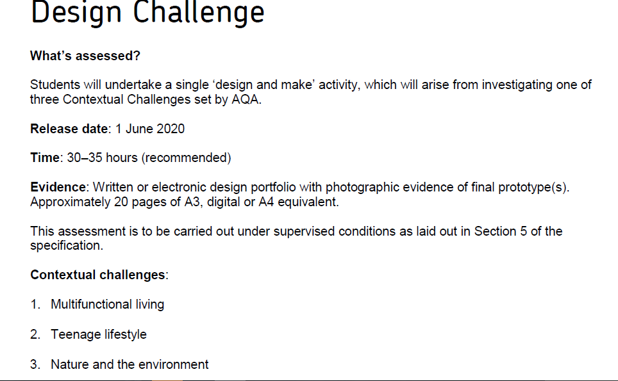

Slide 2
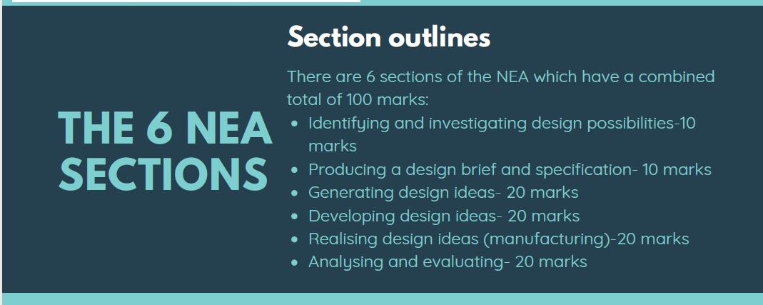

Slide 3
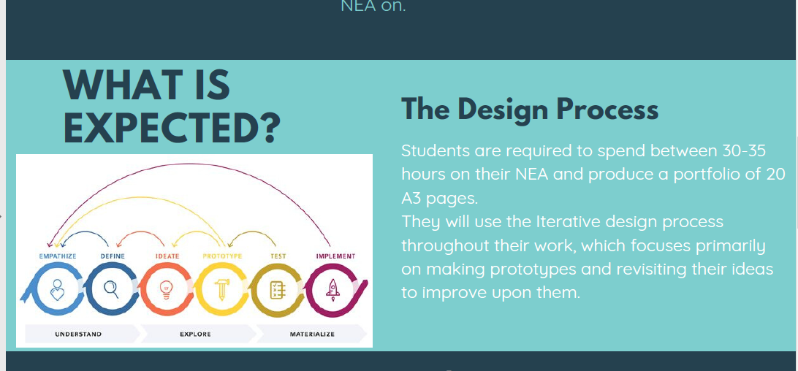

Slide 4
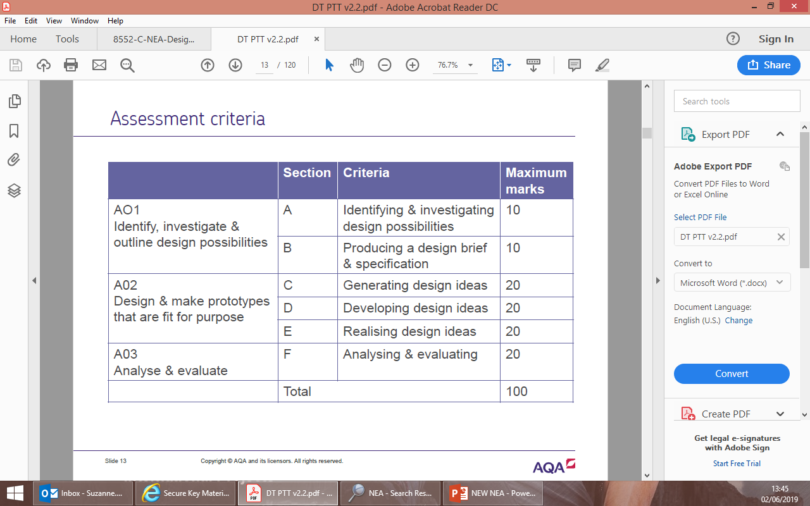

Slide 5
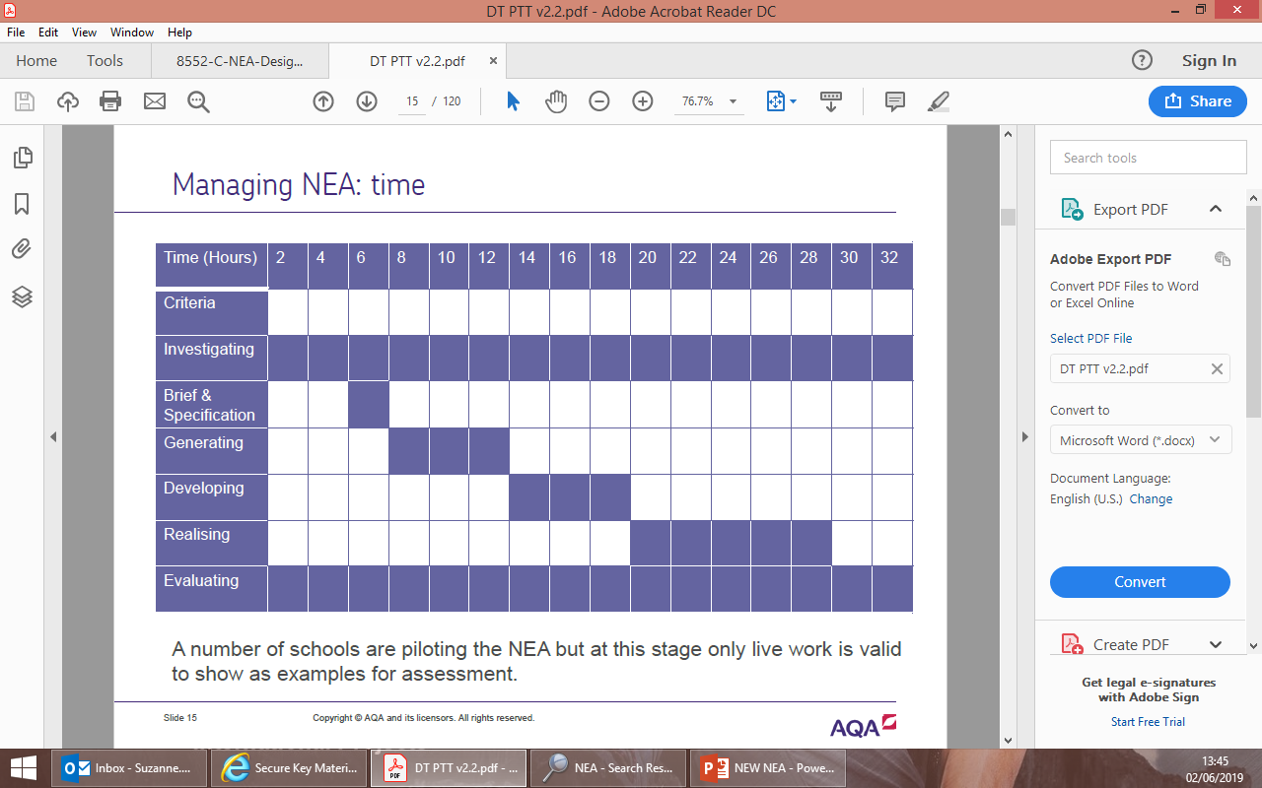

Slide 6
Task 1 teenage lifestyle research/ look at mark scheme for NEA 13-18
Pick 1 area of teenage lifestyle and counter culture that you identify with e.g. Sporty people, gamers, emo, skater, chavs, anime, Kapok, fast food, climate activists, particular fashion styles and sub groups etc.
Find images and information that is associated with this sub counter culture
Collect images with are synonymous with teenage lifestyle
Mind map things you think off to do with teenagers

Slide 7
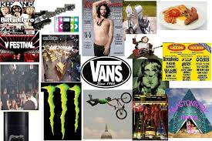

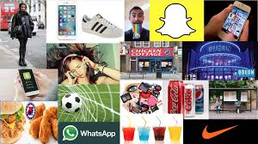
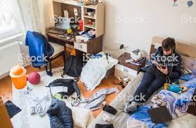
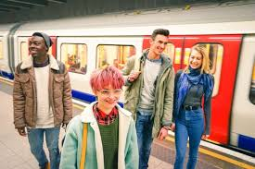
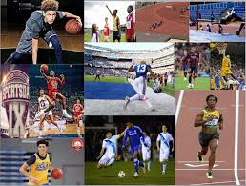
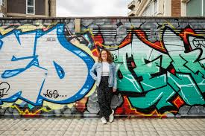
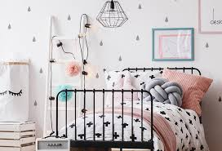
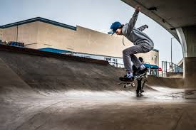

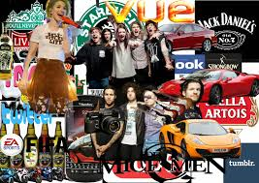
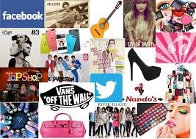
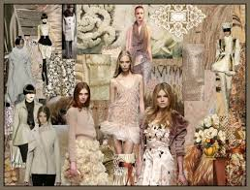

Slide 8
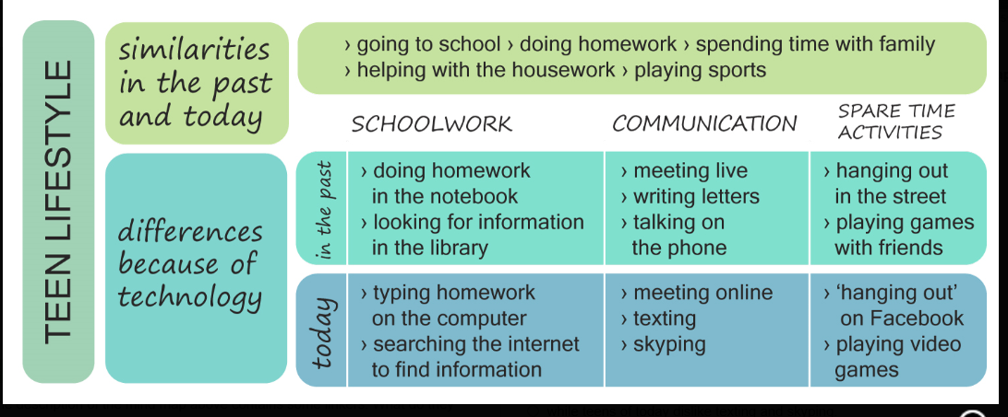

Slide 9
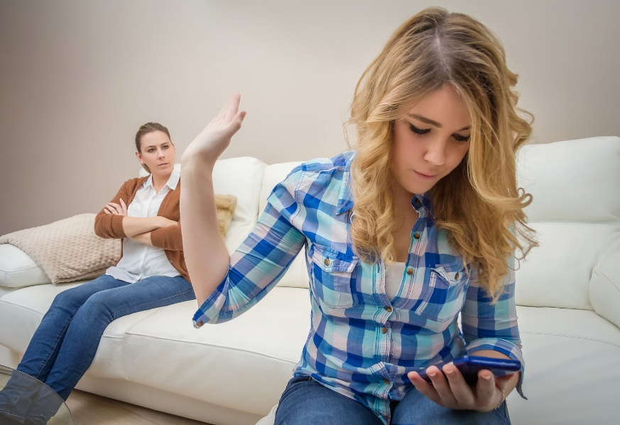


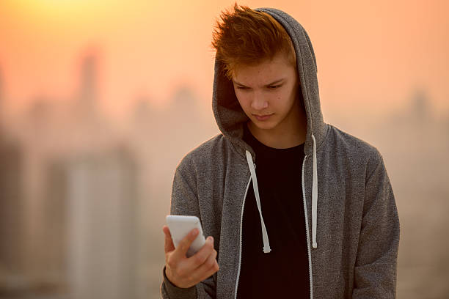
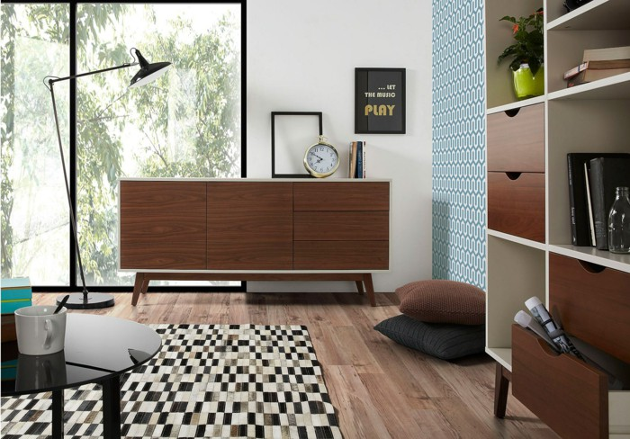
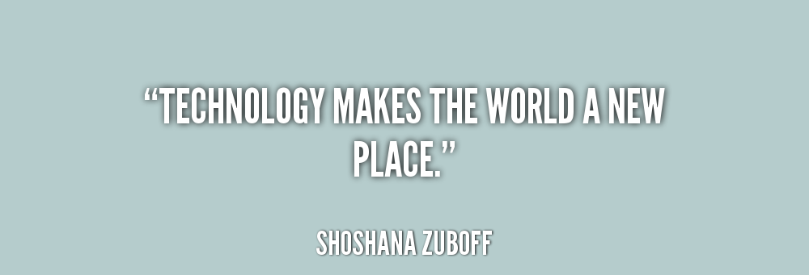
Age group : 15-20 years old because it will have a modern look however will be in the style of a designer in the last 100 years.
Interest: interest in music , 60s style especially furniture with wood , technology.
Hobbies: music , social media , socializing , being around musical areas.
Style: 60s style , wooden designs,
Male /female? Anyone
Music? Any music would suit with the design of the docking station.
Design : wooden , pure and modest yet very presentable.
Technology: phones , computers , speakers, earphones, music , docking station.
Personality: entertaining , imaginative , addicted to social apps , considerate , intellectual , humorous and adoring.
Other: My proposal of this docking station has a wide range of style towards many dissimilar people but it the whole project combines with music , style and technology, perfect for any teenager!

Slide 10
Task 2 identify a client/target market –specific person you will design for and type of person you will market product at
Pick a friend/ family member who is a teenager that you can ask questions to throughout your project. Could even be a sibling at university
They will help you make decisions when researching, designing, developing, making and evaluating during the project
Do a day in the life for that person you pick- what they do from when they get up till they go to bed
You can include
What time they get up, what they do in morning, what they eat, gadgets they use
How they get to school/job
Gadgets they use during day
Do they have a healthy lifestyle/ enjoy cooking
Part of clubs after school extra curricular
How carry books/ equipment
Activities they undertake during the day
Hobbies / interests/ things like to do e.g. what watch on YouTube, Netflix, music
Could think about before coronavirus and now
When they have tea / nutrition /
Any jobs ?
What they do in evening e.g. studying, gaming, listening to music
Issues that effect them racism, mental health, sustainability, politics, activists like Greta Thunberg social, moral ethical issues they think are important

Slide 11
What is a client ?
This is normally the person who has commissioned you with designing and making a product. It will probably be the person you are design for, such as a customer.
On the Client Profile sheet you need to include some details about your customer. An example is seen below and includes suggested subtitles to a variety of short sections
Think about what questions you need to ask them in a short interview about the problem.
Their answers should lead you in different directions with your project.

Slide 12
Task 3 interview client -YOU WANT TO KNOW THEIR NEEDS AND WANTS ARE–WHAT DO YOU NEED TO KNOW?
Ask them some questions / interview to find out what they do on a day to day basis to try to pick out an area/problem you can solve e.g. gaming, studying, applying make up, getting ready to go out, lighting in their room, lack space in room, getting out of bed in morning, equipment for sport, carrying out a particular task
Age
Have they got any family members/ siblings they live with
What are their hobbies interests?
Do they use social media if so what for? What social media
What issues do they have carrying out their hobbies and interests
What music do they like?
Shops they like to go to?
Part time jobs?
What is their style- could show them different images like Apple product, modernist product, post modernist image, a colour chart, different materials etc.
Where do they study? Any issues studying?
How is their bedroom decorated/ colour scheme
How much disposable income have they got?
Are they interested in sustainability

Slide 13
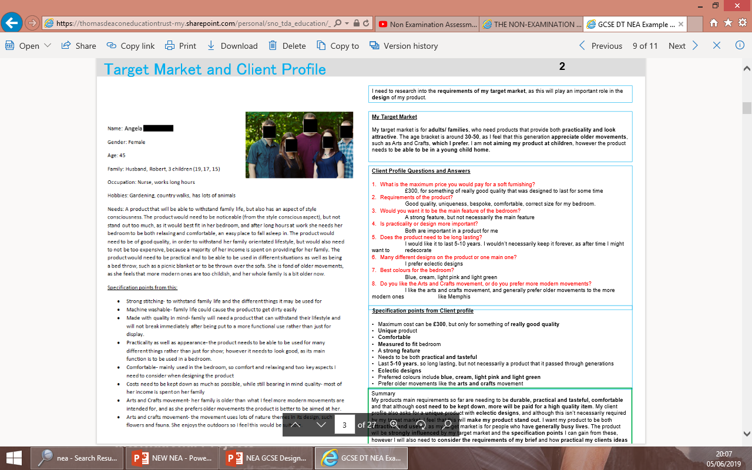

Slide 14
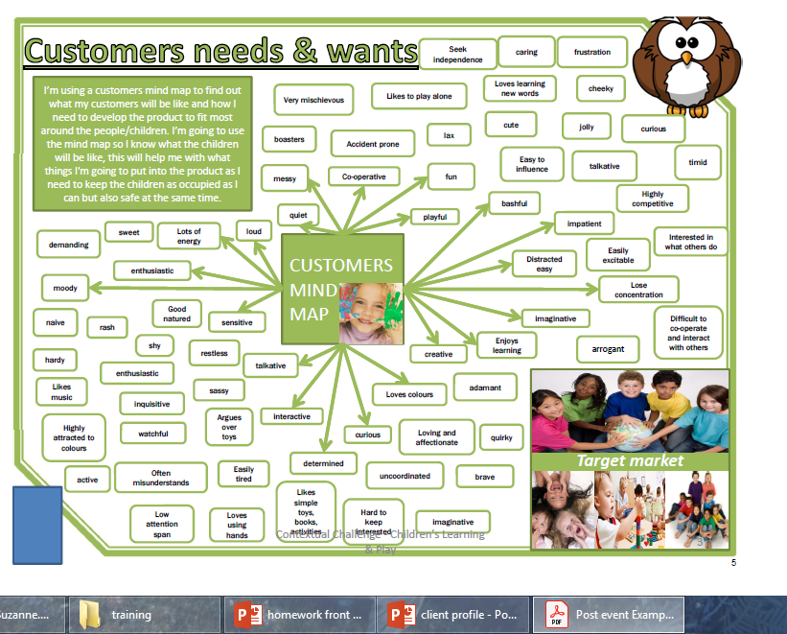

Slide 15
Task 4 target market profile about the general type of person the product will be marketed/sold to
See examples
You could do a questionnaire/target market user group where you ask around 10 teenagers some questions to find out what sort of problems they encounter in their lifestyle, then pick a sort of product that may solve this issue

Slide 16
What is a user/target market?
A target market is the market a company wants to sell its products and services to, and it includes a targeted set of customers for whom it directs its marketing efforts.
Identifying the target market is an essential step in the development of a marketing plan.

Slide 17
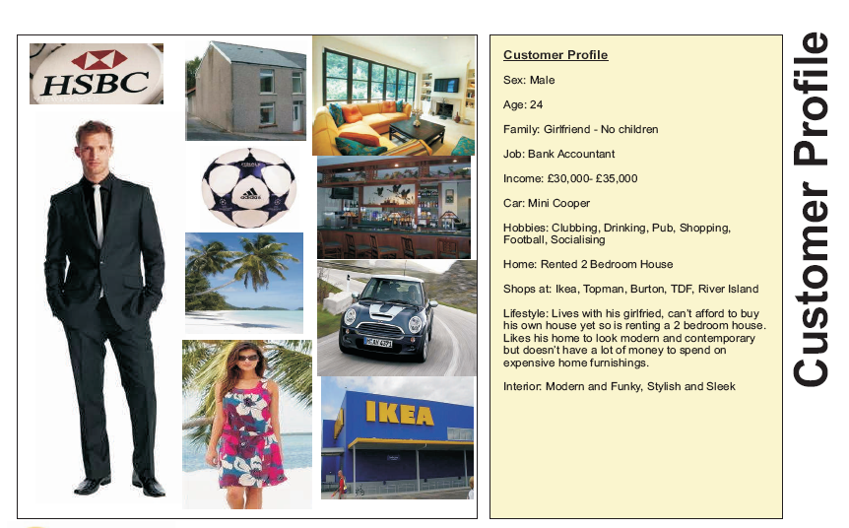
Target market User Profile
Introduction: Tell the examiner why you are completing this page. Talk about what your brief has stated you must create and what are you hoping to achieve. What is the importance of finding a specific client and how it will help your project? What will completing this page help you achieve?
Name:
Age or age range:
Sex:
Likes:
Dislikes:
Hobbies and Interests:
Style:
Income:
Job:
Shops mostly at:
Favorite Websites:
Likes to visit:
Disabilities:
Any other important info :
Complete the Target User Profile by adding as much detail as possible about the intended user. Give details of any specific requirements that the target user might have or want? ( write in sentences mind your GAPS
You must insert a picture of your target user and some pictures to represent their lifestyle
Also include an image of your commemorative product, major sporting event and promotional items you could use to market event.
If you cannot get a photograph of the real target user then find an image of someone who is similar in age , style, sex etc
Think about the shop that your commemorative product will be sold in
Summary: Tell the examiner what you have learnt / found out from completing this page. What do you believe the main influence that this page will have on your project? Why? What do you believe are the key things that you will take from this page that could influence your project? Why?

Slide 18
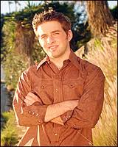
Music
He likes most genres of music and he has lot of CDs. He would like a place to store his favourite CDs in their cases.
Design
He likes to be modern, he has lot of technology. He enjoys looking at arty designs. He owns some of Philippe stark's products and like his designs.
Client profile
Other info
He would like it to be different to most of the storage on the market. He would it to have a drawer he can put random things that clutter up his apartment in as he is very untidy. He likes items that are have an expensive look. He likes a gravity defying bookcase made by malangana design.
Hobbies and interests
He enjoys bmx-ing, football, skateboarding, looking at art, listening to music, reading magazines, playing pool, snooker and darts.
Finance
He has a well paid job but he doesn’t want to spend to much so he will go for quality of product over helping the environment.
Technology
He owns lots of gadgets, these have lots of chargers and cables that get tangled up. But he already has a place to store theses ,this does show that he is modern.
20 year old man
How he spends his time
When he is not doing his hobbies he likes to spend his time reading magazines and listening to CDs
Friends
He likes to show off new things to his friends. He has a wide range of friends and he likes to have them round his house.

Slide 19
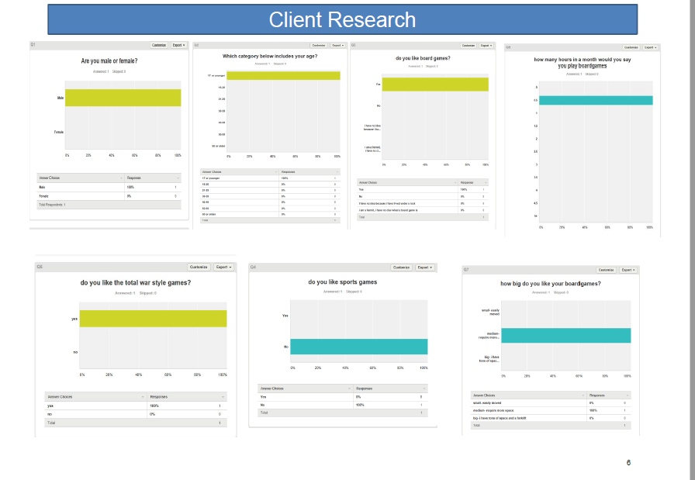

Slide 20
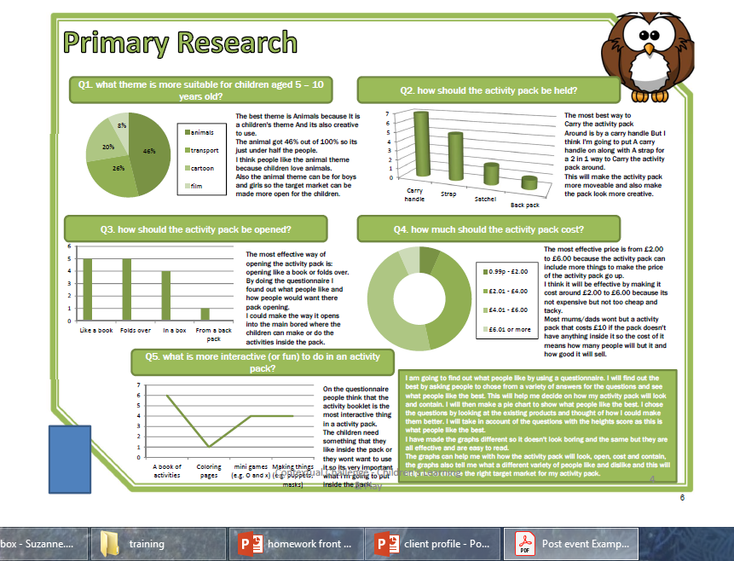

Slide 21
Extension you could
Look at analysis of the context teenage lifestyle
Try to pick out problems you can solve from different areas of their life and interests

Slide 22
Mind map example analysis of teenage lifestyle and things to consider when developing a product
Disabled/other needs
Hobbies/interests
Reduce C02/sustainability 6 r’s
Safety standards?
For manufacturer and user
Teenagers 13-21
Why ?
Where ?
Materials?
Who ?
safety?
Every day activities / problems
Write your problem area here Teenage lifestyle
Manufacture?
Anthropometrics/ergonomics
Issues?
When?
Function?
How?
What?
Wall planter

Slide 23
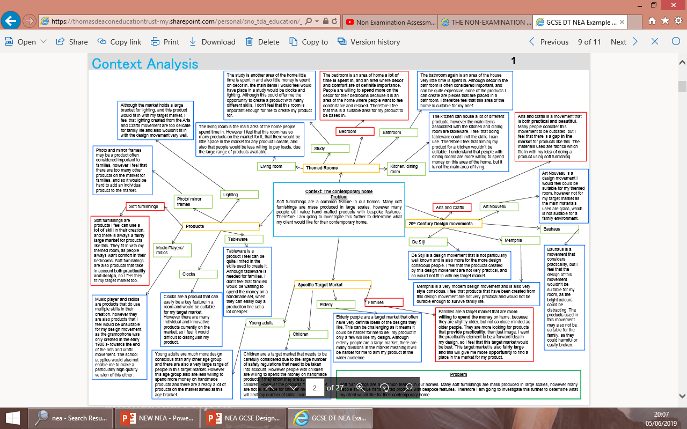
Example of a student mind maping their context area

Slide 24
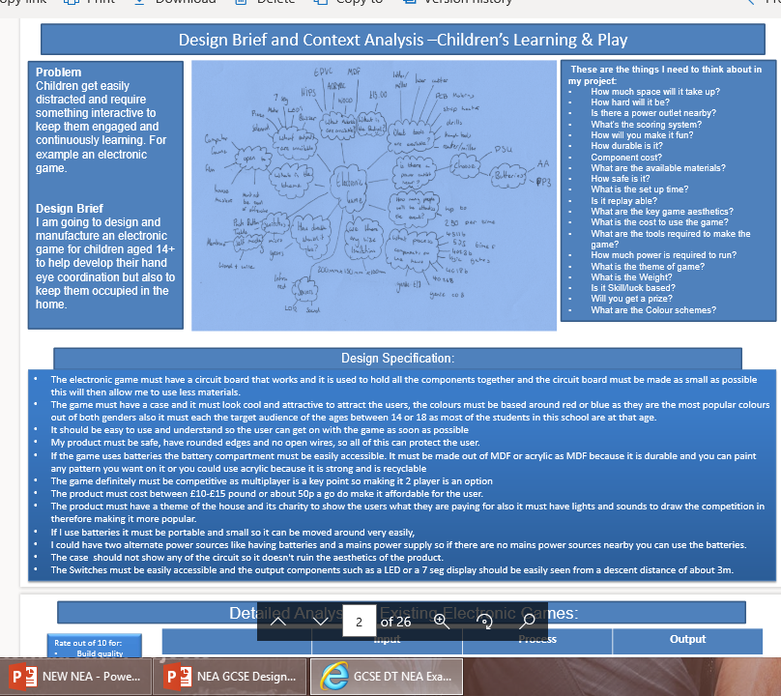

Slide 25
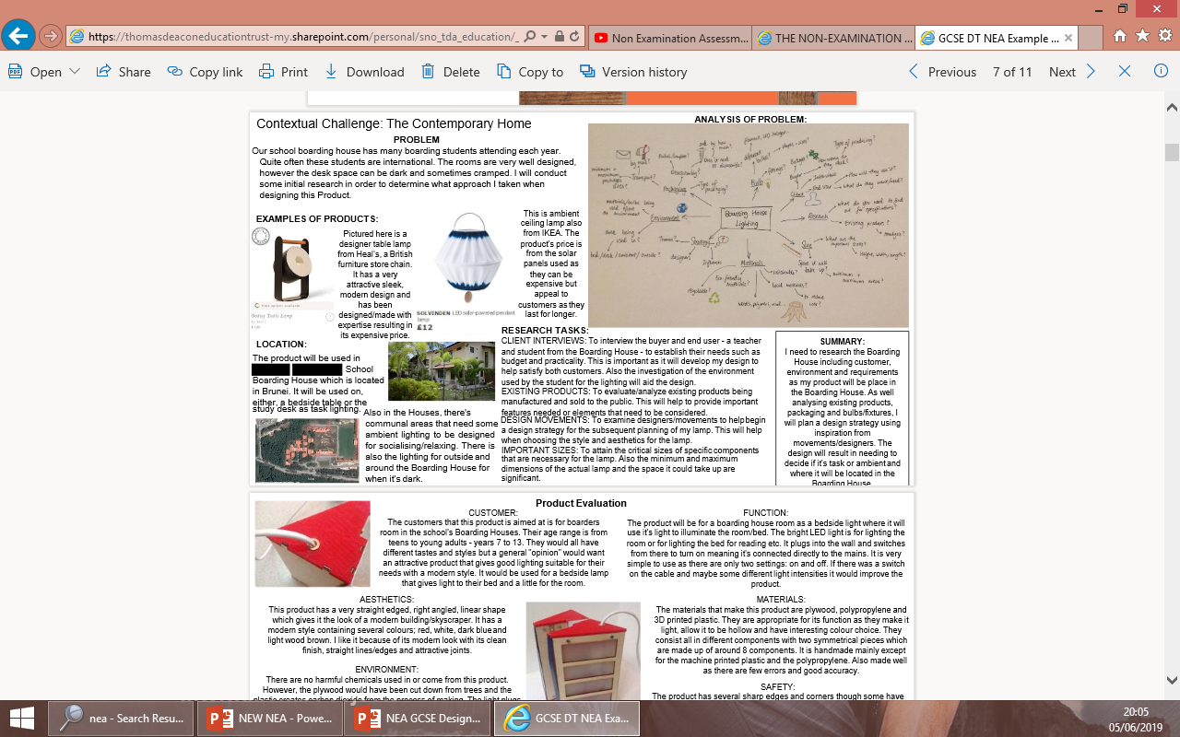

Slide 26
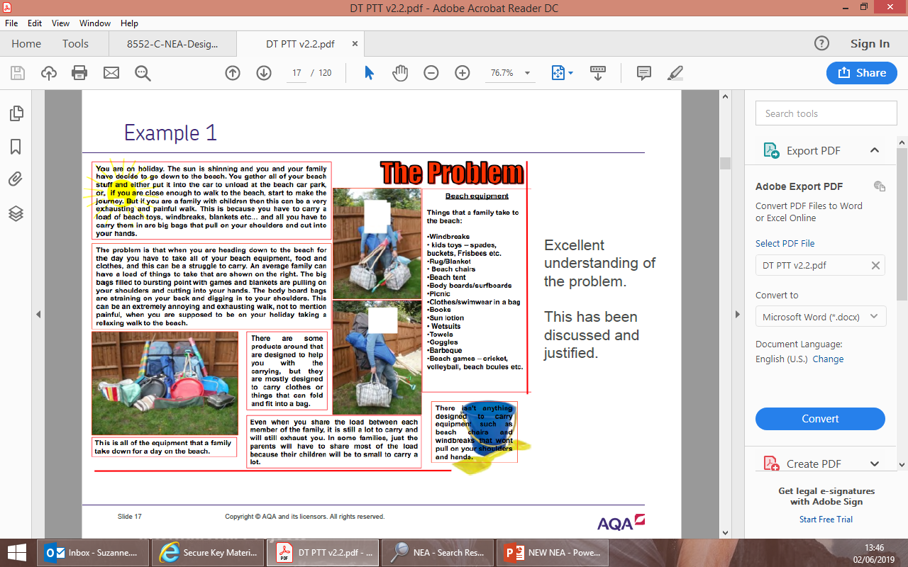

Slide 27
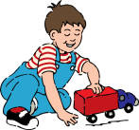
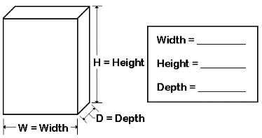
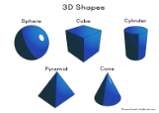




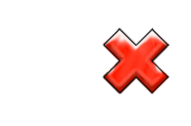
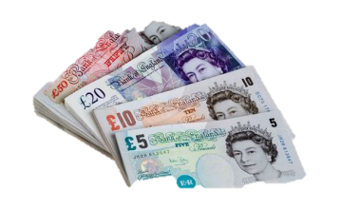


Size
Manufacture and material
Function
Design specification
Have you covered
WHO, WHY, WHAT,WHERE, WHEN
How big is it? Is it an appropriate size? Would it work better if it was bigger or smaller? Weight limit other specifics
How big is it? Is it an appropriate size?
It is ……..mm x ……..mm x ………mm big.
What is the intended function? Does it function as intended?
What will the product be used for? Where will it be used? Are there any fastenings or components e.g. Screw
The product will be used to…….
What material has it been made from? How has it been made? Would a different material make it better? How many have been made?
What material has it been made from? Why did they pick that? Special properties e.g. SPECIAL PROPERTIES e.g. transparent, malleable, light, strong Have they used a smart or Modern/New material/ Bio material
The joint which has been used to construct the box is…………. It has been made from.....
Aesthetics
Environment/ Sustainability
Fully describe the shape, colour and decoration, style, cultural influences
The theme is?
The shape is….. The colours that have been used are…..
Can it be recycled? Is it environmentally friendly? Could it be made more sustainable? Is it a sustainable source e.g. Pine timber or oil based Acrylic?
Can it be recycled? Is it environmentally friendly? The 6 r’s
It can / can’t be recycled. Remember the 6 r’s Reduce waste Finite/non finite
ACCESS FM Product analysis
Safety
How has the user been protected from harm? Are there any hazards?
Could the product be dangerous? Loose components British/ European/ ISO standards
Cost
Customer/ user/client needs
Is it good value? Will the customer afford it? How much does it cost? Where is it from? What overhead costs are there?
How much does it cost RETAIL?
It would cost £………. to buy. Manufacture costs like over heads
Who might use the product? Why is it suitable for them? Why is it better than other products? What age are they?
Who might use the product? Why is it suitable for them?
It would be bought by…….. Who would sell the product? Client working for?? Special requirements Anthropometrics/ Ergonomics
?

Slide 28
SPECIFICATION
T | Target Market – Who is the product is aimed at ? Who do you think will buy this product and use it ? ( not always the same )
S | Size & weight– Are there any restrictions ? Can you specify a max or minimum size/wieght at this stage ?
E | Ergonomics – Do you know what part of the body will interact with the product ? What measurements will you need to ensure comfort/ ease of use for the consumer ? Will the age or size of the user be important ?
S | Safety – How will you ensure the product is safe for the manufacturer to make and the consumer to use.
D | Durability – How long do you expect your product to last ? Will there be any maintenance required during normal use ? Should it be able to withstand misuse ?
F | Function – How do you want the product to work, will you include some unique features ? What need or purpose will it fulfil ?
A | Aesthetics – The product aesthetics (how it looks). Does it need to match a particular style, colour or pattern. How could you make it appealing to your target user/market ?
M | Materials – What could the product be made out of? Which properties should be considered essential/desirable when designing?
M | Manufacturing – Does your product and material choice need to use a specific process ? Are you expecting to manufacture a prototype or batch ?
S | Sustainability- How will you ensure your product is part of the closed loop ? How will you consider the carbon foot print of your product ?
C | Cost- How much would this product se££ for ? Where would you expect to sell it ? How would material choice influence this ?
P | Packaging – Does the product need to be flat-packed ? Do you need to include assembly instructions or guidance for its use ? What components/tools need to be included ? How would your product need to be protected ?

Slide 29
Safety | How secure the product is for the manufacturer and the consumer.
Anthropometrics | The measurement data of the body needed to produce an accurate product that fits the user correctly.
Function | How the product works.
Ergonomics | Size of cushion
Materials | What the product is made out of.
Issues | The environment, Moral and Social needs need to be considered when making any product.
Cost | How much the product is for the manufacturer to make and for the consumer to buy.
Consumer | Who the product is aimed at.
Form | How it looks
Manufacturing | How the product is made, One - off (one item is made),

