Slide 1
3.1.3 SWOT analysis A Level Edexcel New Specification 2015 Business

Slide 2
From the specification
a) SWOT analysis
internal considerations: strengths and weaknesses
external considerations: opportunities and threats

Slide 3
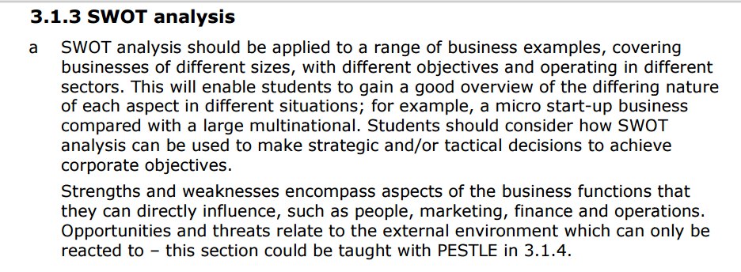
Guidance from Edexcel

Slide 4
Lesson Objectives
To be able to use a SWOT analysis to interpret internal and external considerations
To be able to answer sample exam questions based on the topic area

Slide 5
Starter
What are your strengths and weaknesses?

Slide 6
SWOT analysis
Strengths; Internal factors within a business that can help it achieve its objectives
Weaknesses; Internal factors that could prevent a business from achieving its objectives
Opportunities; External business circumstances that can help it achieve its objectives
Threats; External problems that may prevent a business from achieving its objectives

Slide 7
Strengths
What advantages does your organisation have?
What do you do better than anyone else?
What unique or lowest-cost resources can you draw upon that others can't?
What do people in your market see as your strengths?
What factors mean that you "get the sale"?
What is your organization's Unique Selling Proposition (USP)?
Notes:
http://www.mindtools.com/pages/article/newTMC_05.htm

Slide 8
Weaknesses
What could you improve?
What should you avoid?
What are people in your market likely to see as weaknesses?
What factors lose you sales?
Notes:
http://www.mindtools.com/pages/article/newTMC_05.htm

Slide 9
Opportunities
What good opportunities can you spot?
What interesting trends are you aware of?
Useful opportunities can come from such things as:
Changes in technology and markets on both a broad and narrow scale
Changes in government policy related to your field
Changes in social patterns, population, lifestyle changes, and so on
Local events
Notes:
http://www.mindtools.com/pages/article/newTMC_05.htm

Slide 10
Threats
What obstacles do you face?
What are your competitors doing?
Are quality standards or specifications for your job, products or services changing?
Is changing technology threatening your position?
Do you have bad debt or cash-flow problems?
Could any of your weaknesses seriously threaten your business?
Notes:
http://www.mindtools.com/pages/article/newTMC_05.htm

Slide 11
SWOT analysis: micro business
Website here
The Isle of Jura is nestled off the West Coast of Scotland. It's only 60 miles as the crow flies from Glasgow but takes a wee while to get there. One road, one distillery, one pub, one shop and one community. It's often been described as remote and even George Orwell went so far as to say it was 'the most un-get-at-able place', whilst he was writing 1984.

Slide 12
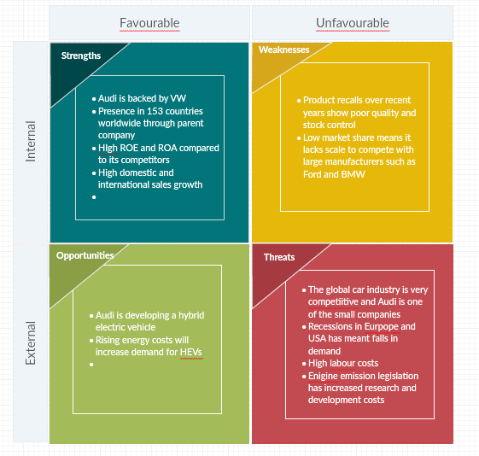
SWOT analysis MNE - Audi

Slide 13
SWOT as a strategic and tactical tool
Strategic tool;
Strength> opportunities; used to formulate a strategy of growth and attack to use the business’s strengths to maximise opportunities in the market
Strength> threat; used to compete and defend, using the strengths to minimise the market threats
Weaknesses> opportunities; used to improve and attack new markets or produce new products
Weaknesses> threats; used to identify when to change and retreat
Tactical tool;
Useful as part of the planning process to attract investors and funding

Slide 14
Glossary
Strengths; How can we Use each Strength?
Weaknesses; How can we Stop each Weakness?
Opportunities; How can we Exploit each Opportunity?
Threats; How can we Defend against each Threat?
USED SWOT!
Notes:
* Idea from https://rapidbi.com/swotanalysis/#gettingSWOTSused

Slide 15
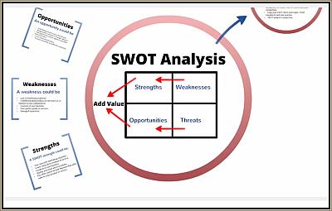
Revision Video

