Slide 1
3.1.4 Impact of External Influences A Level Edexcel New Specification 2015 Business
.

Slide 2
From the specification
a) PESTLE (political, economic, social, technological, legal and environmental)
b) The changing competitive environment
c) Porter’s Five Forces

Slide 3
Guidance from Edexcel

Slide 4
Lesson Objectives
To be able to understand the PESTLE analysis tool
To be able to discuss the changing competitive environment
To be able to interpret Porter’s five forces model
To be able to answer sample exam questions based on the topic area

Slide 5
PESTLE (political, economic, social, technological, legal and environmental)

Slide 6
PESTLE analysis
This is a business analysis tool that aims to look at external factors and how they may have an impact on the business
This aids strategic and tactical decision making, objective setting and helps a business to reach its goals.
Political, Economic, Social, Technological, legal and environmental
Starbucks example PESTLE analysis here

Slide 7
Read the Starbucks article on the previous page
Convert each letter into a picture to help you remember
2) Read through the article
3) Reduce each letter into three key points
4) Which is the most important letter and why?
5) Least important letter and why
Notes:
Possible class split
Changes in external environment

Slide 8
Political
P
A business should examine how they may be affected by:
A change in government, BBC article here
Government intervention polices
Influence of the EU on trading
Tax rates (e.g. increase in VAT here)
Tariffs (when importing into the UK)

Slide 9
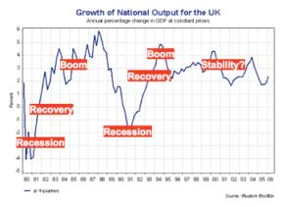
Economic
E
A business should analyse how they may be affected by
An increase in interest rates here
An increase in inflation
Unemployment rates video here
Recession
The business cycle

Slide 10
Social
S
A business should analyse how they may be affected by changes in social factors
A change in demographics and its impact on products produced and markets, here
Culture mix changes in the UK, here
Social trends e.g. Vaping here

Slide 11
Technological
T
A business could examine the impact of new technologies on their operations, for example;
Automation, new robotics and how it can improve productivity
Innovations in the industry
Research and development in the industry
New computer systems
Trading online

Slide 12
Legal
A business should assess how they may be impacted by changes in legislation for example;
Health and safety at work act in terms of PPE and regulations, Guardian article here
Data protection Act, article here
Sale of Goods Act
Sex Discrimination Act

Slide 13
Environmental
E
A business could analyse their environmental challenges that may face the business;
Climate change, caused by farming? See article here
Weather (e.g. in farming and tourism)
Sustainable production and CSR
Disappearance of wildlife, article here

Slide 14
Porter’s Five Forces

Slide 15
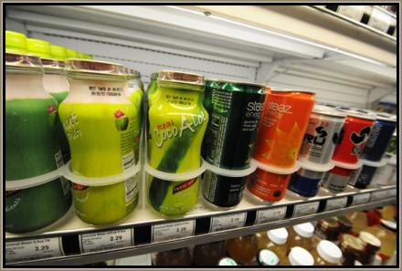
Starter
You buy a can of coke every morning. You go to your usual shop and “oh no” they have run out of coke. What do you have instead?
Notes:
This will get students to start talking about substitute products which comes up in the Porter’s 5 forces model, how does Coke deal with these new entrants, are their high barriers? No, but Coke heavily advertises and builds a strong brand to prevent you from switching to a substitute…

Slide 16
Porter 5 Forces
What are the 5 forces?
Apply to the supermarket sector
Apply to the fashion sector

Slide 17
Porter’s 5 forces
In 1985 Porter argued that there were 5 forces (or factors) which determine the profitability of an industry.
Bargaining power of suppliers
Bargaining power of customers
Threat of new entrants
Threat of substitutes
Rivalry among existing businesses

Slide 18
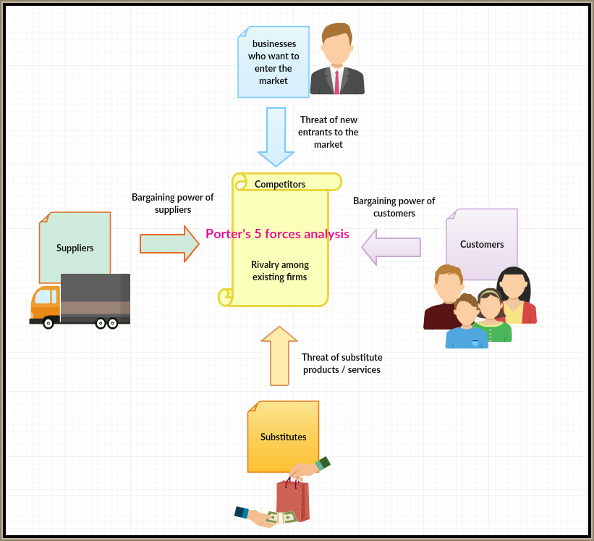
Give an example for each one for Supermarket sector
Notes:
Students copy this down and then review

Slide 19
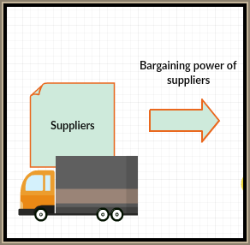
Bargaining power of suppliers and customers
Bargaining power of suppliers;
Limit power of suppliers by looking for new suppliers
Backward vertical integration and merge or takeover the supplier
Bargaining power of customers;
Make it too expensive for a customer to switch
Forward vertically integrate

Slide 20
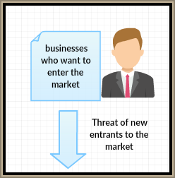
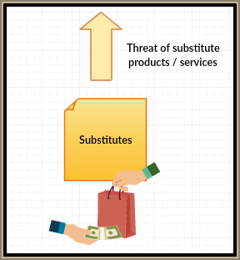
Threat of new entrants and substitutes
Threat of new entrants;
Create barriers to entry to prevent new entrants
Heavily advertise to build strong brands
Threat of substitutes;
Continuously invest in R&D and develop patents
Buy up patents of rivals and shelve to prevent product production

Slide 21
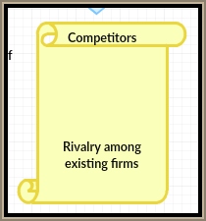
Rivalry amongst existing firms in the industry
Create a cartel – which is illegal but quite commonplace
Buy up rivals through horizontal integration
Continuously introduce new products to the market
Heavily advertise to maintain market share

Slide 22
Sample questions

Slide 23
Sample question 1

Slide 24
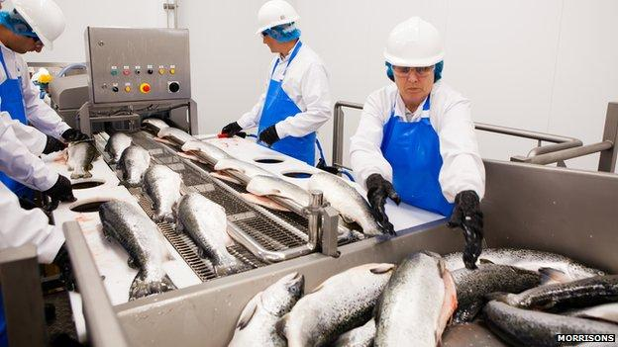
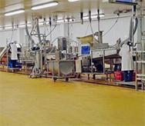
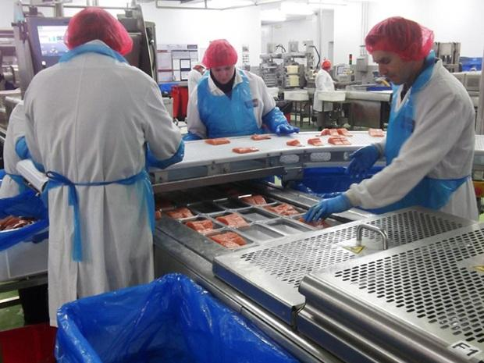
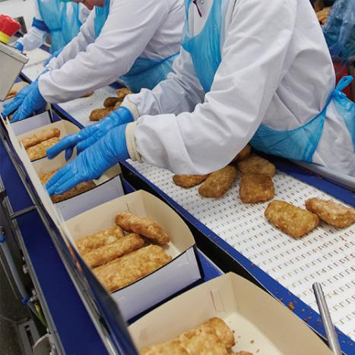
Why is technological change important? Consider productivity…
What technology might be involved in making fish products?

Slide 25
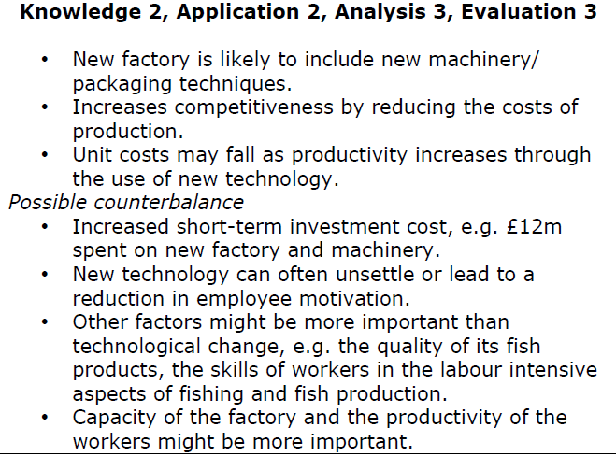
Answer question 1

Slide 26
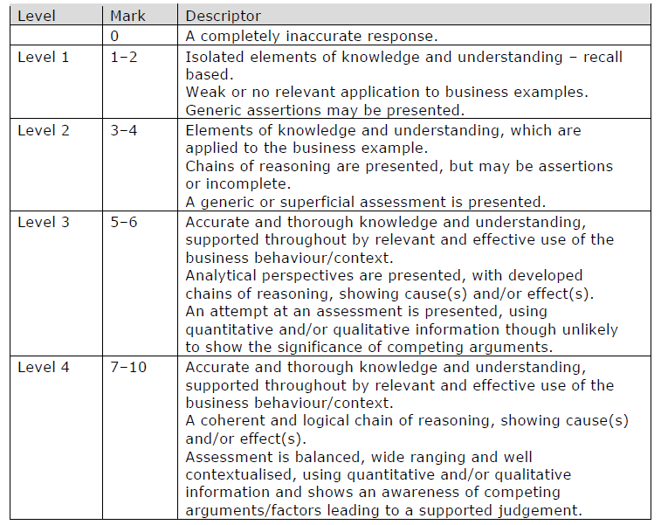
How to level a 10 mark question

Slide 27
Sample question 2
2 marks
Case on next slide

Slide 28
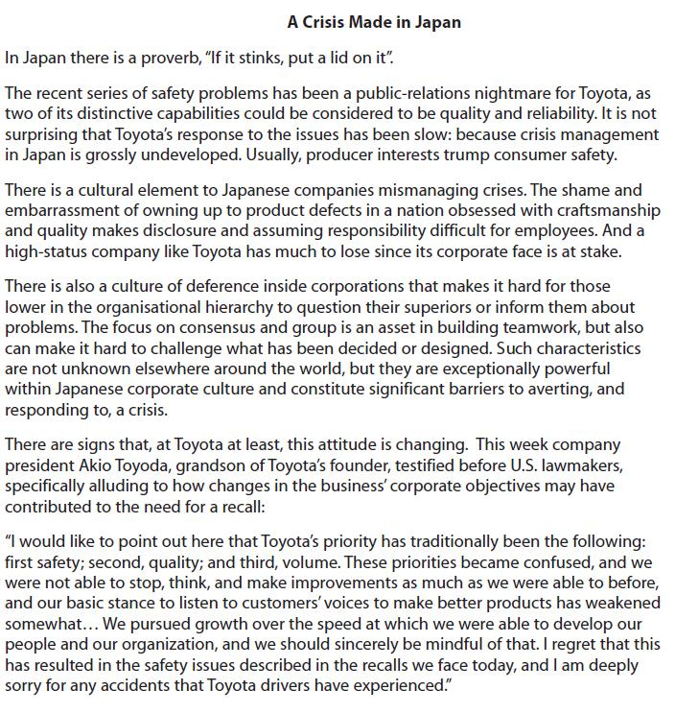
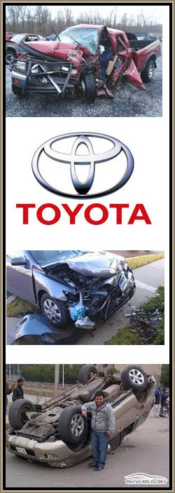

Slide 29
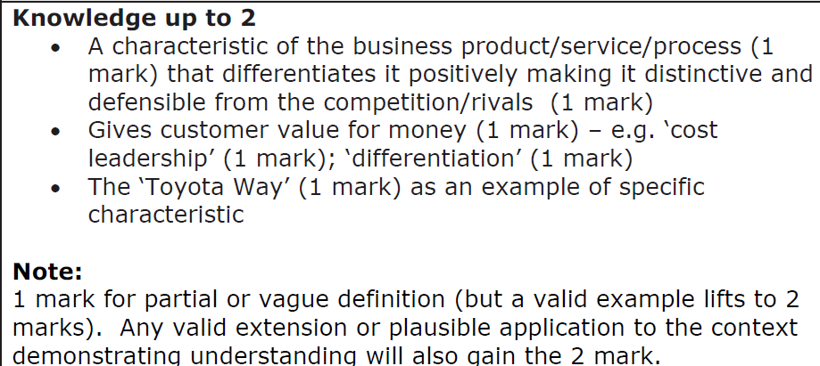
Answer question 2

Slide 30
Revision Video

Slide 31
Another video

Slide 32
Glossary
PESTLE; Political, Economic, social, technological, legal and environmental external analysis of a business
SWOT analysis; Strengths, weaknesses, opportunities and threats of a business
Porter’s 5 Forces; Analysis tool for examining ways for a business to gain competitive advantage
Barrier to entry; factors which make it difficult for new businesses to enter a market

