Slide 1
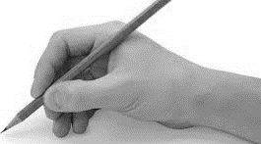
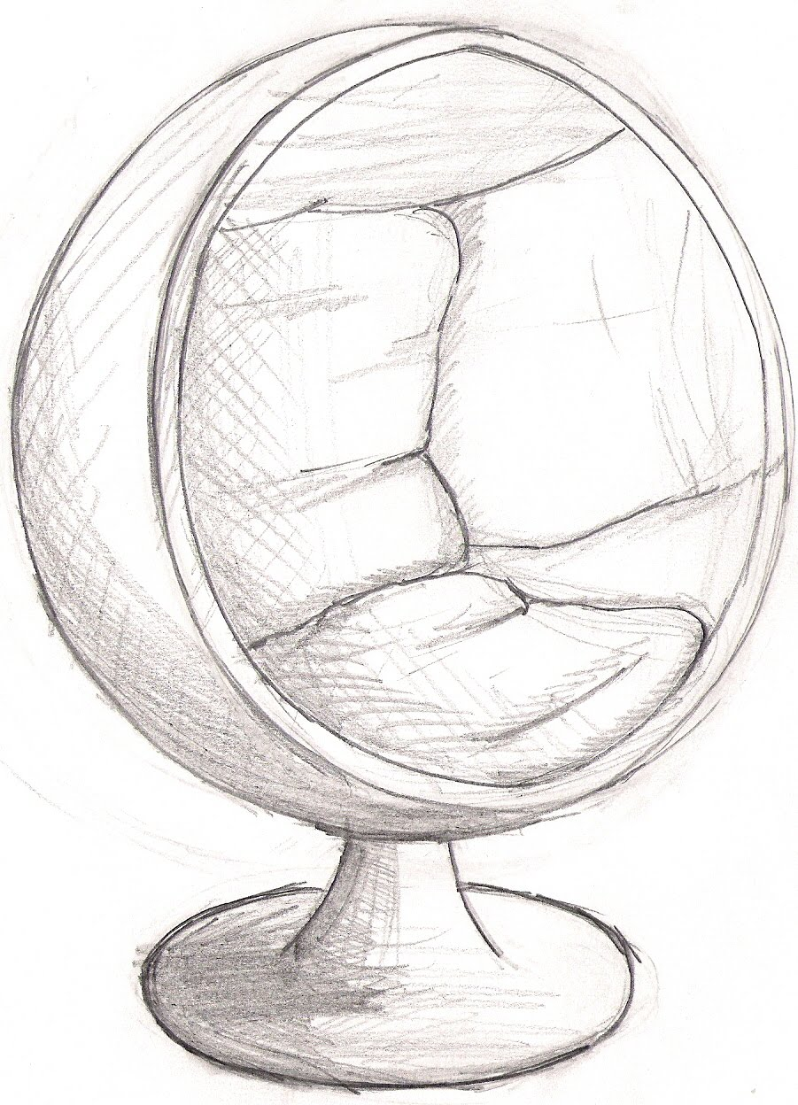
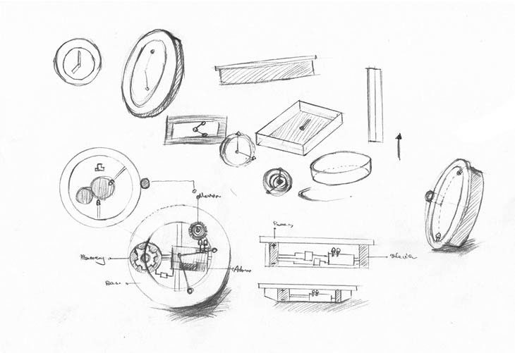
Picture it !
Name:
Year 7 Class:
Teacher:
Current Grade:
Target Grade:

Slide 2
Title of Project: Picture it ! Learning aims: Use of basic graphical skills, Develop basic sketching skills Develop knowledge of key terminology, Develop knowledge of basic geometrical shapes and how to draw them. Applying knowledge to simple design challenge. Skills: Developing freehand sketching skills, Learning how to sketch in 3D, Annotation of work |  | Name: Teacher: Current Level: End of key stage target:
Objectives
 |  | Strength | Improvement action | Tick when complete | Feedback SIA
1 | Know and use the correct equipment for sketching design ideas
 | Demonstrate pencil control, thick and thin lines, simple shapes
 | Develop skills in freehand 2d line drawing of geometric shapes
2 | Recap on pencil control, thick and thin lines
 | Practice drawing more complex 2d shapes
 | Apply this knowledge to simple line drawings
3 | Learn about isometric drawing for 3d forms using a grid
 | Apply line drawing skills to a variety of 2d and 3d geometrical shapes/forms
 | Apply new skills to produce accurate 3d forms without a grid
4 | Learn new enhancement techniques – shade, shadow and thick/thin lines
 | Be able to apply skills on to 3d geometric forms
 | Applying drawing skills learned to accurately sketch and render
5 | Mini design challenge
 | Using and embedding all skills practiced to design either a clock or a chair
 | Apply a variety of skills to communicating design ideas for a clock or chair
6 | Mini design challenge
 | Using and embedding all skills practiced to design either a clock or a chair
 | Apply a variety of skills to communicating design ideas for a clock or chair

Slide 3
Lesson 1 Learning aims
1: | Know and use the correct equipment for sketching design ideas
2: | Demonstrate pencil control, thick and thin lines, simple shapes
3: | Develop skills in freehand 2d line drawing of geometric shapes

Slide 4
Lesson 1 Learning aims
1: | Know and use the correct equipment for sketching design ideas
2: | Demonstrate pencil control, thick and thin lines, simple shapes
3: | Develop skills in freehand 2d line drawing of geometric shapes

Slide 5
Lesson 2 Learning aims
1: | Recap on pencil control, thick and thin lines
2: | Practice drawing more complex 2d shapes
3: | Apply this knowledge to simple line drawings

Slide 6
Lesson 3 Learning aims
1: | Learn about isometric drawing for 3d forms
2: | Apply line drawing skills to a variety of 2d and 3d geometrical shapes/forms
3: | Apply new skills to produce accurate 3d forms

Slide 7
Lesson 3 Learning aims
1: | Learn about isometric drawing for 3d forms
2: | Apply line drawing skills to a variety of 2d and 3d geometrical shapes/forms
3: | Apply new skills to produce accurate 3d forms

Slide 8
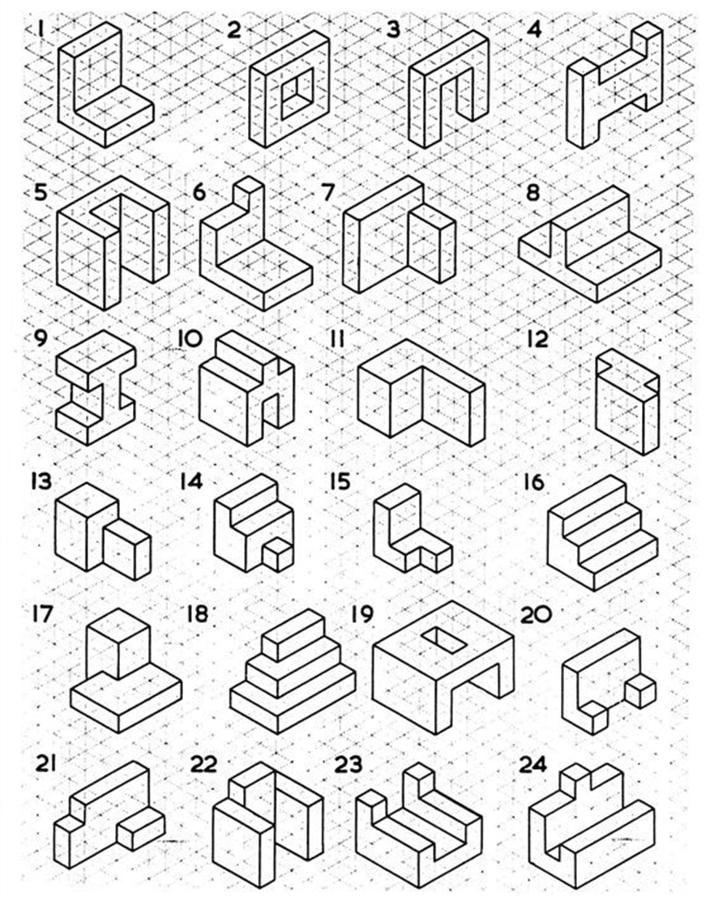
Lesson 3 Extension task Select 3 shapes and copy them onto the space on the right of the page.

Slide 9
Lesson 4 Learning aims
1: | Learn new enhancement techniques – shade, shadow and thick/thin lines
2: | Be able to apply skills on to 3d geometric forms
3: | Applying drawing skills learned to accurately sketch 3D shapes

Slide 10
Lesson 4 Learning aims
1: | Learn new enhancement techniques – shade, shadow and thick/thin lines
2: | Be able to apply skills on to 3d geometric forms
3: | Applying drawing skills learned to accurately sketch 3D shapes

Slide 11
Lesson 5 Learning aims
1: | Learn new enhancement techniques – shade, shadow and thick/thin lines
2: | Be able to apply skills on to 3d geometric forms
3: | Applying drawing skills learned to accurately sketch and render

Slide 12
Lesson 6 Learning aims
1: | Mini design challenge
2: | Using and embedding all skills practiced to design either a clock or a chair
3: | Apply a variety of skills to communicating design ideas for a clock or chair

Slide 13
Lesson 7 Learning aims
1: | Mini design challenge
2: | Using and embedding all skills practiced to design either a clock or a chair
3: | Apply a variety of skills to communicating design ideas for a clock or chair

Slide 14
Lesson 8 Learning aims
1: | Mini design challenge
2: | Using and embedding all skills practiced to design either a clock or a chair
3: | Apply a variety of skills to communicating design ideas for a clock or chair

