Slide 1
Home learning lesson 7:
Fake news

Slide 2
Learning outcomes:
What is fake news
Why is fake news a problem
Covid-19 examples of fake news
Fake news in politics
How to spot fake news

Slide 3
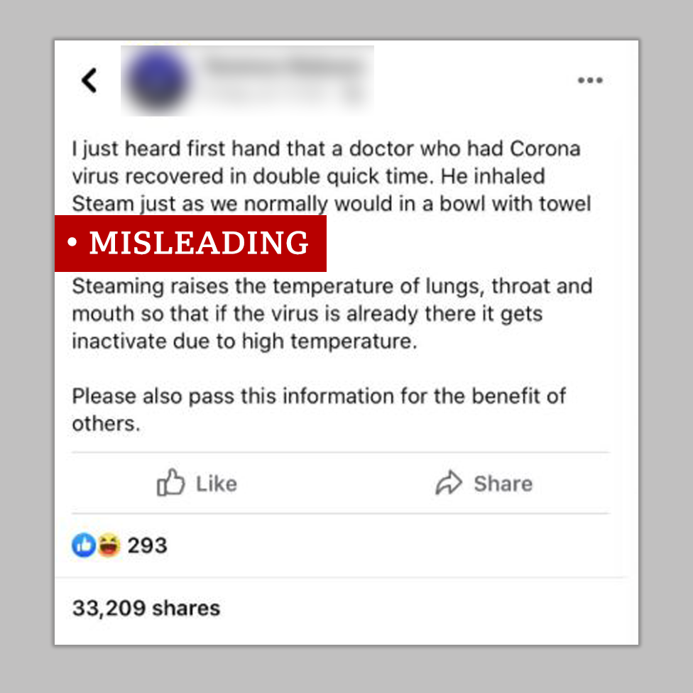
What is fake news?
Fake news is news or stories (often on the internet) that are not true.
There are two kinds of fake news:
False stories that are deliberately published or sent around, in order to make people believe something untrue or to get lots of people to visit a website. These are deliberate lies that are put online, even though the person writing them knows that they are made up.
Stories that may have some truth to them, but they're not completely accurate. This is because the people writing them - for example, journalists or bloggers - don't check all of the facts before publishing the story, or they might exaggerate some of it.
It is happening a lot at the moment, with many people publishing these stories in order to get as many shares as possible.

Slide 4
Why is fake news a problem
Fake news is a problem for different reasons.
The first kind of fake news - deliberate lies - is a problem because it can make people believe things that are completely untrue.
The second kind - when people publish something without checking that it's completely right - can make people have less trust in the media, as well as make everyone believe something that might be inaccurate.
People also only tend to share things that they agree with. So if people are sharing a lot of fake news, and lots of people believe it, it's easy to get sucked into a bubble that is actually completely different to the real world - and a long way from the truth.
If you are unsure about a story, you can check with an adult or used a trusted website.

Slide 5
Fake news – Covid-19
How fake news has led to patients refusing treatment
Fake news can be a problem if the news means people don’t seek the correct medical attention.
Read this article to find out more:
https://www.independent.co.uk/news/uk/home-news/coronavirus-fake-news-conspiracy-theories-antivax-5g-facebook-twitter-a9549831.html

Slide 6
Fake news in politics
When is fake news not fake news?
Sometimes, a story might be called fake news (when actually it isn't) by someone, or a group of people, who don't want to accept that the news is true - even if it might be.
They will tell people that a story is fake, just because they don't want it to be true.
Some people will call things fake news, when really they just have a different opinion.
Calling something fake news, when it isn't really, is a problem as it can mean some people don't know what to believe anymore.
Some politicians and world leaders have responded to the public and news reporters by claiming the issue to be ‘fake news’.
https://www.ft.com/content/55a39e92-8357-11ea-b872-8db45d5f6714

Slide 7
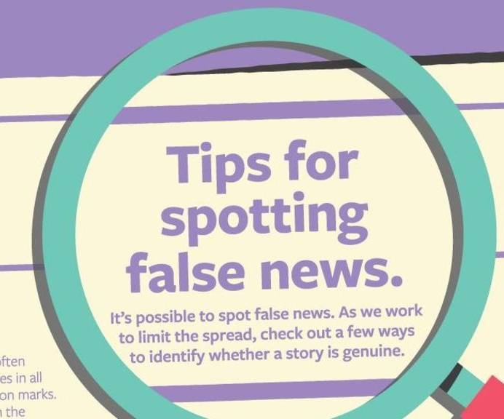
Spotting fake news
Fake news - checklist
If you want to try to make sure that you don't get caught out by fake news, there a few things you can look out for.
Ask yourself:
Has the story been reported anywhere else?
Is it on the radio, TV or in the newspapers?
Have you heard of the organisation that published the story?
Does the website where you found the story look genuine? (meaning it doesn't look like a copycat website that's designed to look like another genuine website)
Does the website address at the very top of the page look real? Is the end of the website something normal like '.co.uk' or '.com', and not something unusual, like 'com.co'?
Does the photo or video look normal?
Does the story sound believable?
If the answer to any of these questions is 'no', you might want to check it out a bit more, before spreading the word.
If you're at all unsure, speak to an adult that you trust about the story to find out a bit more about it

Slide 8
BBC NEWS Live lesson
Fake news and false information
How to sort fact from fiction.
This Live Lesson was designed in collaboration with BBC News to
support young people to identify
real news and filter out fake or false information.
See slides 9-12 for some fun activities.
https://www.bbc.co.uk/teach/live-lessons/bbc-news-live-lesson/zn4kqp3

Slide 9
BBC live lesson activity one – Trust or don’t trust
Activity one
http://downloads.bbc.co.uk/learning/livelessons/BBCNews-Activity-1-Spot-the-Mistake.pdf

Slide 10
Activity two – Why does false news matter
Activity two
http://downloads.bbc.co.uk/learning/livelessons/BBCNews-Activity-2-Why-Does-False-News-Matter.pdf

Slide 11
Activity three – Types of false news
Activity three
http://downloads.bbc.co.uk/learning/livelessons/BBCNews-Activity-3-Types-of-False-News.pdf

Slide 12
Activity four – Trust or don’t trust
Activity four
http://downloads.bbc.co.uk/learning/livelessons/BBCNews-Activity-4-Trust-or-Don't-Trust.pdf

Slide 13
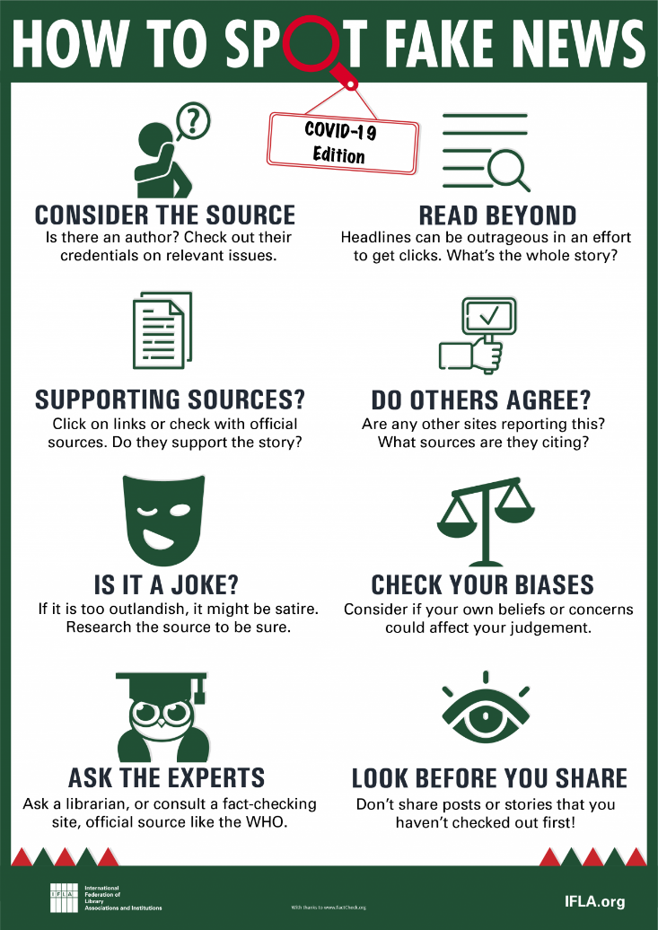
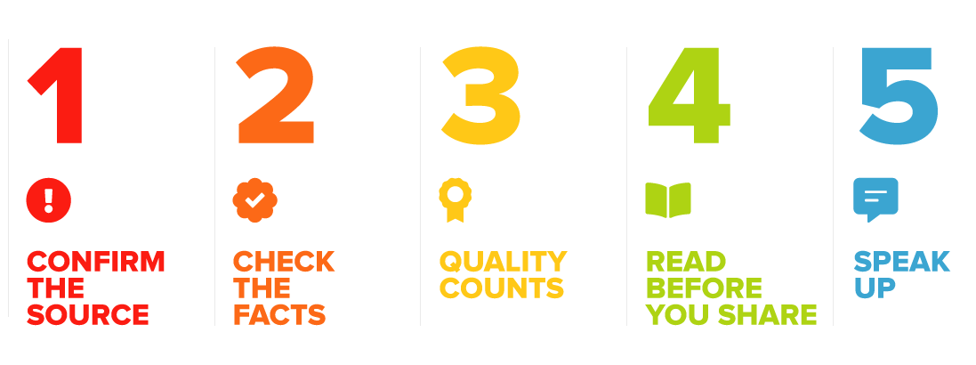
Spotting fake news
A summary of the key points to look out for when reading material on the Internet.
Have a good week, stay safe and keep busy.

