Slide 1


Achievement pathways 2018
Mrs Ruth Fehrenbach
Assistant Vice Principal - Curriculum and Transition

Slide 2
Welcome to our Achievement Pathways Evening 2018
Today’s presentation
What is the Achievement Pathways process?
Which subjects will be studied by all and which are optional at KS4?
How much choice do we offer our students?
What should you consider when making choices?
What support is there in this decision-making process?
What is the deadline for returns?

Slide 3

What is
Achievement Pathways?
The Achievement Pathways process helps students in the transition from KS3 to KS4.
Year 9 students are offered a tailored range of optional subjects to choose from.
Students select courses to study in Key Stage 4 (Years 10-11) which lead to the qualifications that they will achieve at the end of Year 11.

Slide 4
What will I study in years 10 and 11?
Compulsory Subjects - GCSE
Mathematics | 1 GCSE
English Language | 1 GCSE
English Literature | 1 GCSE
Double Science Award | 2 GCSEs
Core PE | -
Personal Development | -

Slide 5
What will I study in years 10 and 11?
Optional Subjects - 3 GCSEs or equivalent
One choice has to be an English Baccalaureate (EBACC) subject
(At least) 1 EBACC Subject
History
Geography
Computer Science
Spanish
French
Triple Science
PLUS 2 OTHER subjects
Some students may be asked to consider taking 2 EBACC subjects with at least one of them being a language which will prepare them for their next step towards a future career path.

Slide 6

Different Types of Qualification
BTEC First Award Level 2 = 1 GCSE
- coursework and exams
GCSE Full course
- ALL exams
- Some with controlled assessments
- ALL taken/submitted at the end of the course
Vocational Level 2 = 1 GCSE

Slide 7
What are the optional subjects?
EBACC subjects – at least one of these
French Spanish History Geography Triple Science Computer Science | ICT Vocational Construction Food prep and Nutrition Engineering Resistant Material Art and Design Art Textiles Photography Health and Social Care RE | Drama Music Dance Media Studies Business Studies Physical Education First Award in Sport Public Services (P7) Computer Science
*Not all subjects may run if numbers are low

Slide 8
The Pathway Process
Students will be offered subjects that they are making progress in at Checkpoint 1 - on or above expectations
Based on our knowledge of student strengths we guide students towards types of qualifications that we feel best meet the needs of each student

Slide 9
 | Academic | Blended | Vocational
Qualifications on offer | GCSEs | GCSE and BTEC | GCSE and BTEC
Compulsory element | One of the EBacc subjects: History Geography French Spanish Computer Science Triple Science | One of the EBacc subjects: History Geography French Spanish Computer Science Triple Science | Personal and Social development
Offer | 2 optional subjects | 2 optional subjects | 2 optional subjects

Slide 10

Sixth Form and university – keeping your options open
For some jobs, but not all, you need specific qualifications e.g. Doctor.
If you really want to be a pharmacist, optometrist, midwife, psychologist or architect, you need to know that some university courses require certain a-levels e.g. maths and/or a science.
Your GCSE grades need to be really strong to access the relevant sixth form subjects.
This may feel a little early, however, your subject choices may impact what you can do next.
What do I need for sixth form?
What are the best subjects for the careers I am interested in?
How will my subject choice be viewed by universities?
Our pathways
Elective
2020
Guided
Facilitating Subjects – you must have two from:
Maths English Lit.
Biology History
Chemistry Geography
Physics Languages
Notes:
Some universities look for a broad and varied academic curriculum
Too narrow a range of subjects and/or a focus on more vocational
courses could limit your options later on.

Slide 11

What support is available in this process?
Prior to the evening
Presentations from each subject and careers reflection in PD
Tonight
Please visit the subject displays and discuss courses in more detail
This term
Academic tutoring - tutors will be
discussing options with their
tutees over the next four weeks.

Slide 12
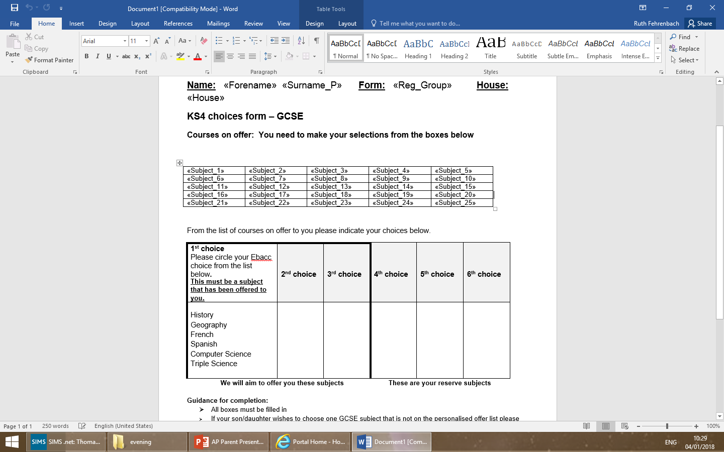
Completing the form
We ask for 6 preferences to give us flexibility
Your preferences are to be selected from your offer list
Deadline Friday 2nd February
Notes:
We will aim to provide students with their first choices - last year over 90% student received their first four preferences

Slide 13
Thank you for listening

